Slide 1
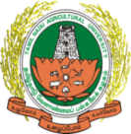
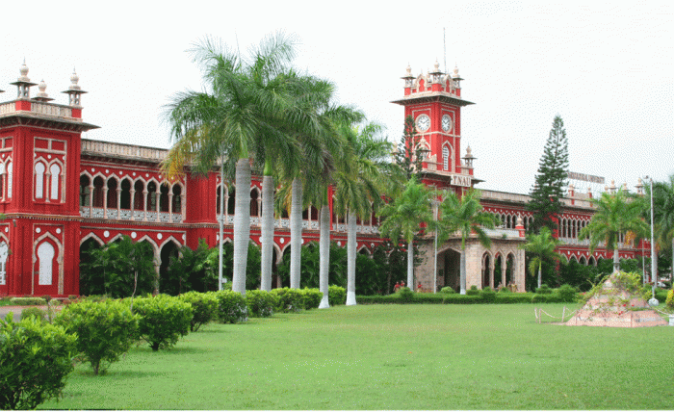
Activities of TNAU in the Promotion of Natural Farming
Nammazhvar Organic Farming Research Centre
Tamil Nadu Agricultural University
Coimbatore, Tamil Nadu

Slide 2
TEACHING

Slide 3
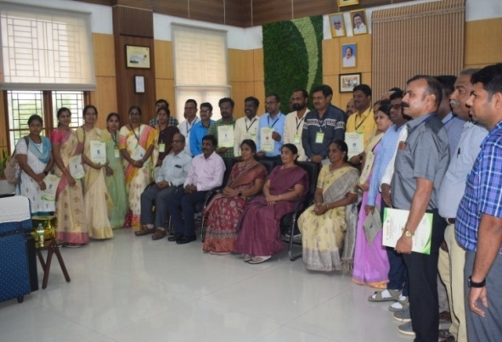
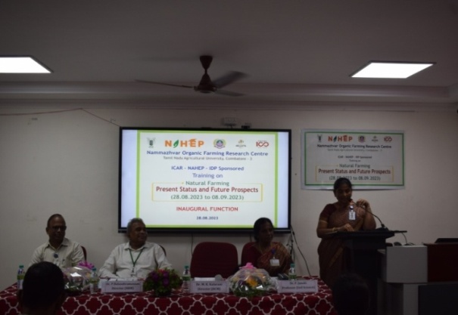
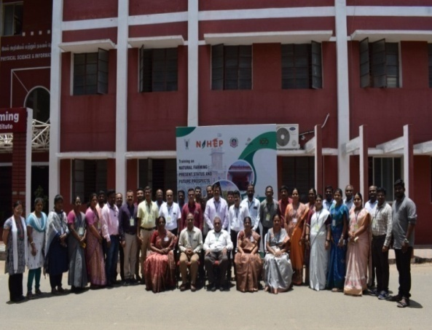
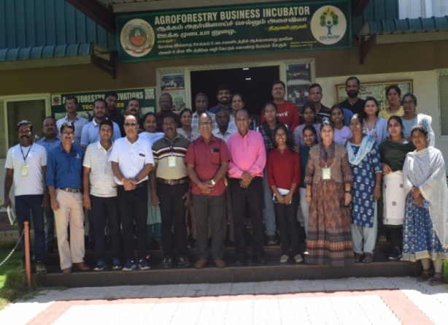
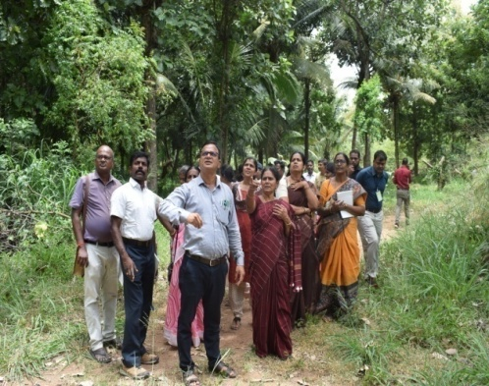
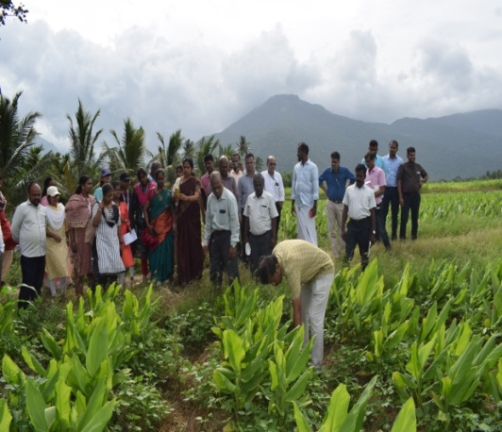
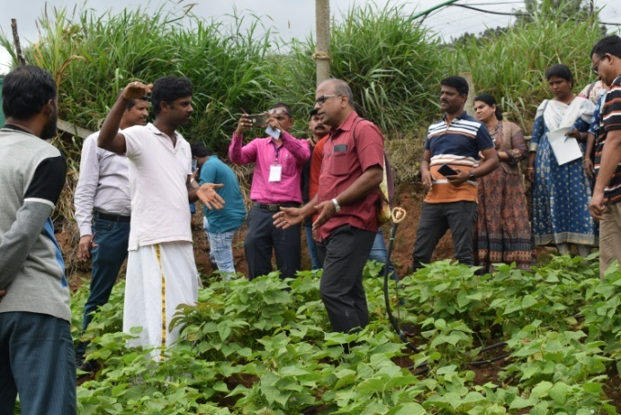
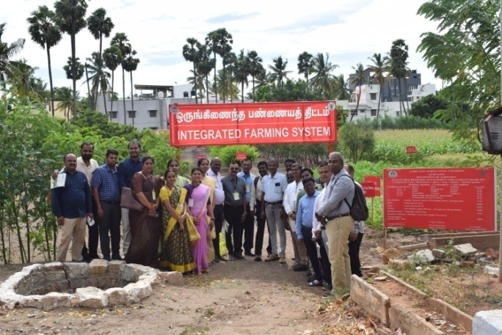
Activities of TNAU in the Promotion of Natural Farming at National level…
TNAU has been selected as one of the 8 universities at national level to organize training on “Natural Farming : Present Status and Future Prospects” to enhance the competency of teachers of SAUs on Natural Farming under NAHEP - IDP
Organized a training from 28.08.23 to 08.09.23 - 30 scientists of 8 SAUs were trained
Second training programme will be organized from 27.11.2023 to 06.12.2023

Slide 4
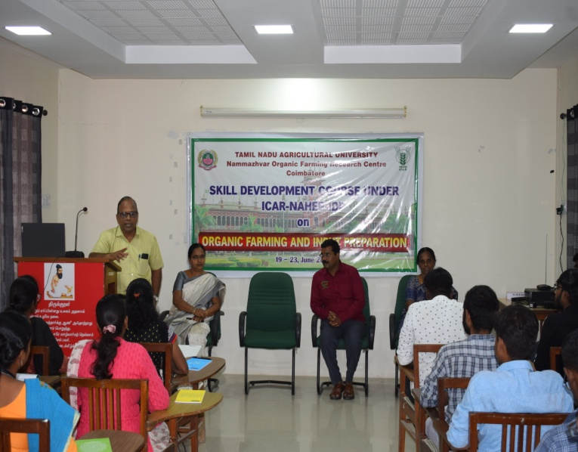
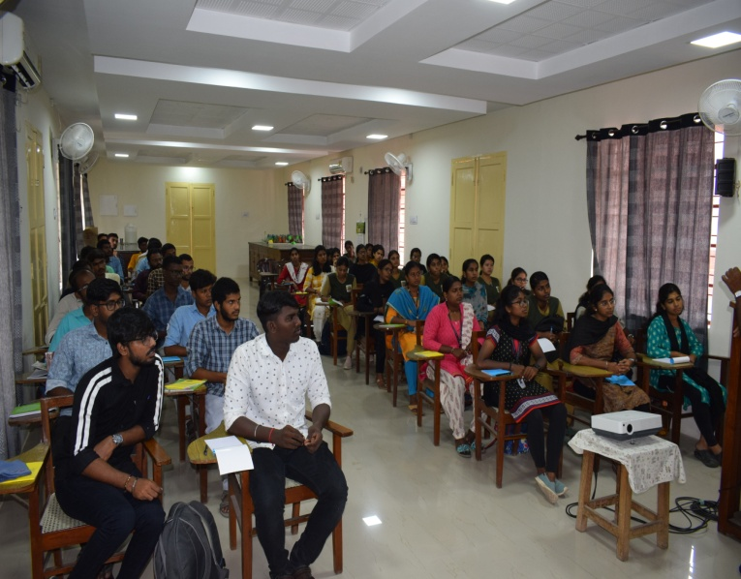
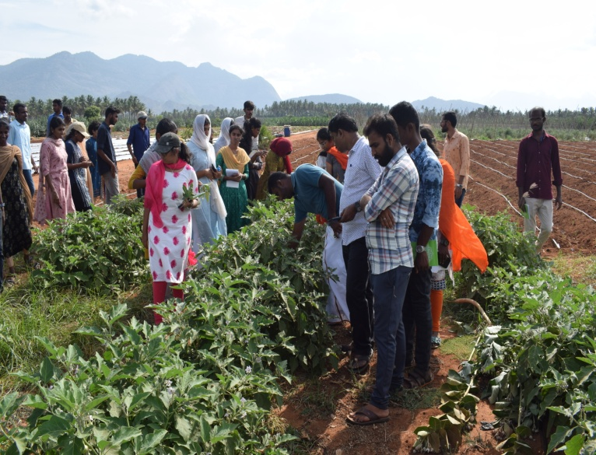
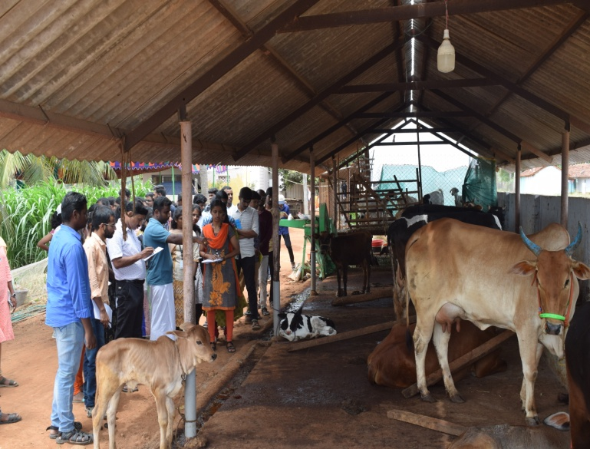
Activities of TNAU in the Promotion of Natural Farming…
TNAU - NOFRC organized 5 days entrepreneurial skill development course on “Input Preparation for organic and natural farming” to the undergraduate students of B.Sc. (Hons) Agriculture 19.06.2023 to 23.06.2023 under NAHEP - IDP.
Experiential learning on “Organic / Natural Farming and Inputs Preparation” to B.Sc. (Agri.) & B.Sc. (Horti.) students

Slide 5
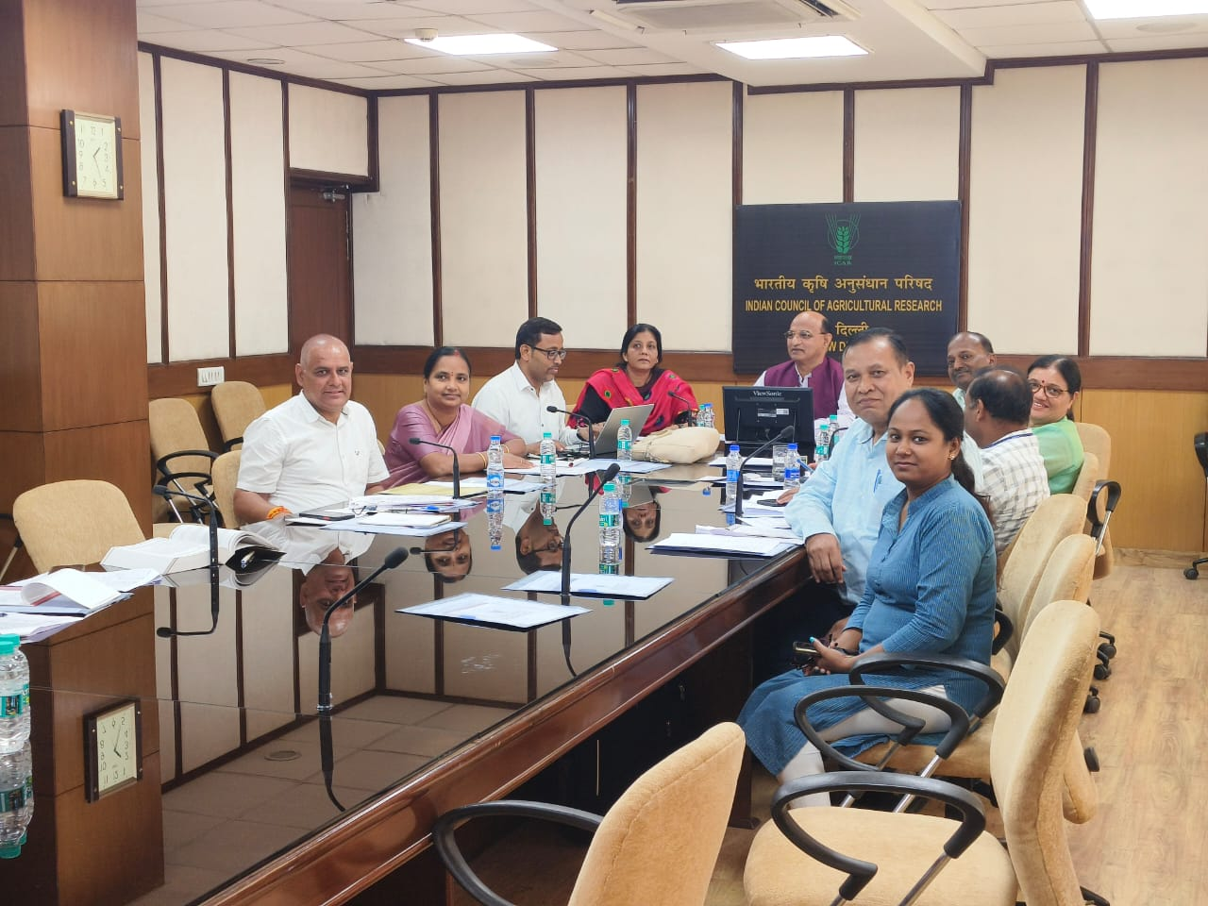
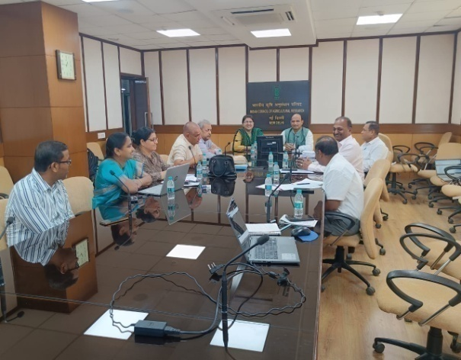
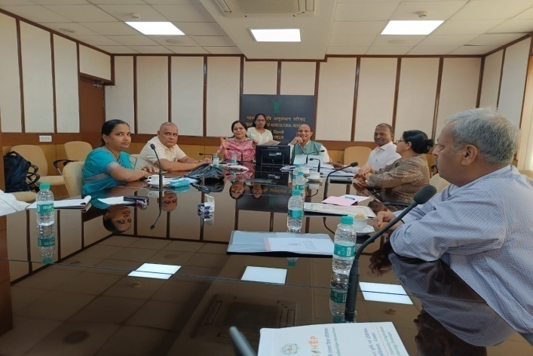
Activities of TNAU in the Promotion of Natural Farming at National level…
Dr. E. Somasundaram, Director (Agri-Business Development) and Dr. M. Suganthy, Professor (Entomology) of TNAU served as Subject Matter Experts in the national level committee and contributed for restructuring the syllabus of Natural Farming as per New Education Policy 2020 for UG Certificate in Natural Farming, UG Diploma in Natural Farming, UG Degree - B.Sc. (Hons) Natural Farming or B.Sc. (Research) Natural Farming
Developed the syllabus for common course on Natural Farming for B.Sc. (Hons) Agriculture / B.Sc. (Hons) Horticulture

Slide 6
RESEARCH

Slide 7
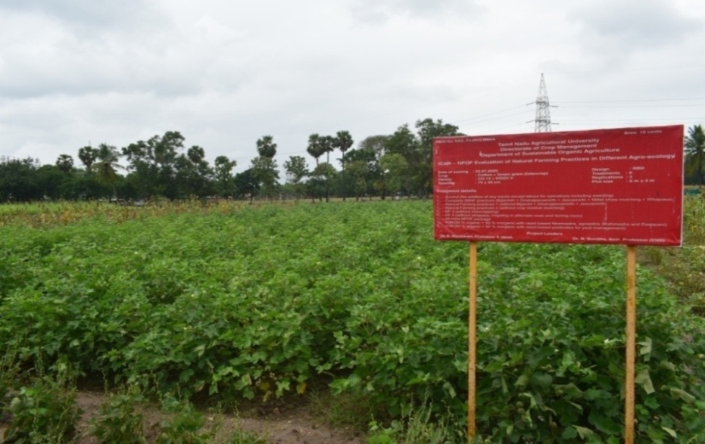
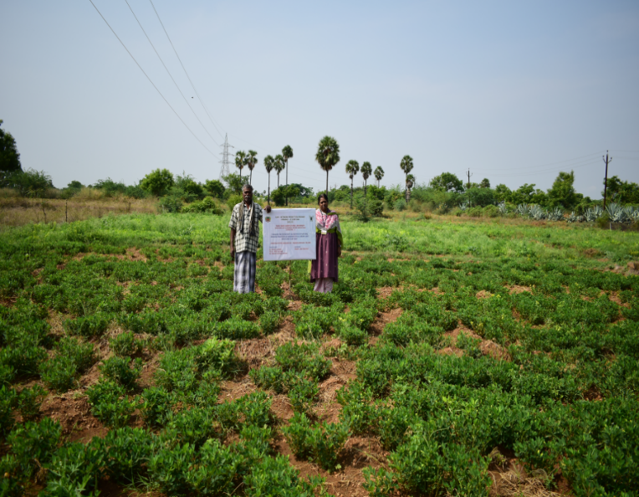
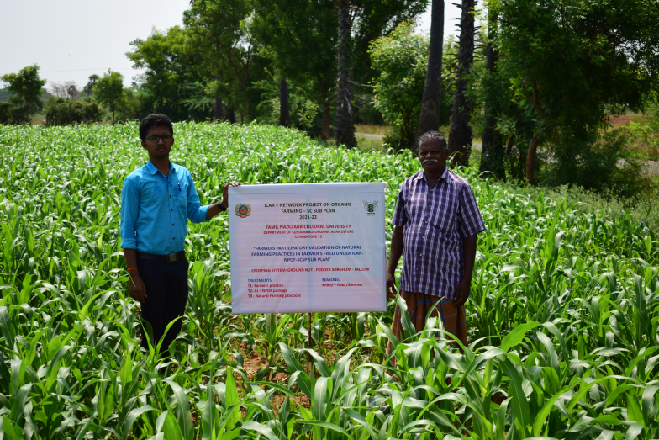
Research Activities of TNAU in the Promotion of Natural Farming at National level
All India Network Project on Organic Farming
Evaluated the cropping system suitable for natural farming: Cotton + Greengram - Sorghum + Chickpea - multivarietal sowing
Completed bio-characterization and validation of natural farming inputs viz., Beejamrit, Jeevamrit, Ghanajeevamrit, Neemastra, Brahmastra
Geo-tagged characterization of farmers practicing natural farming in Tamil Nadu - 23 farmers have been geo-characterized since 2020-21
Farmer’s participatory validation of organic and natural farming practices - 32 trials have been completed since 2020-21 (Cotton - 8; Sorghum - 16 and Groundnut - 8)

Slide 8
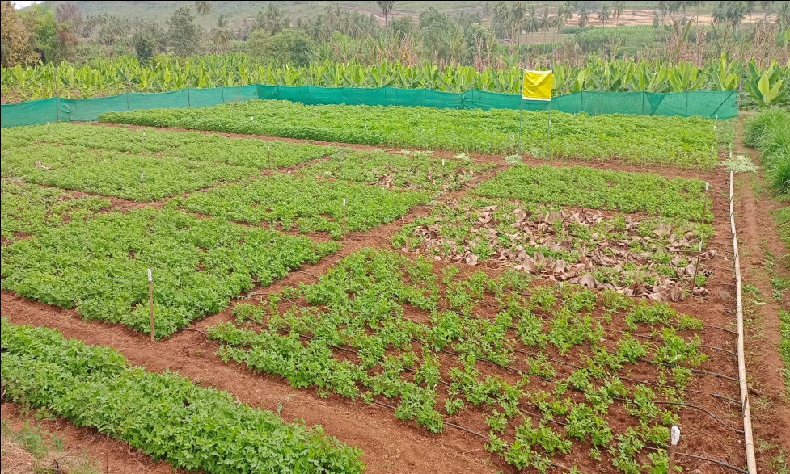
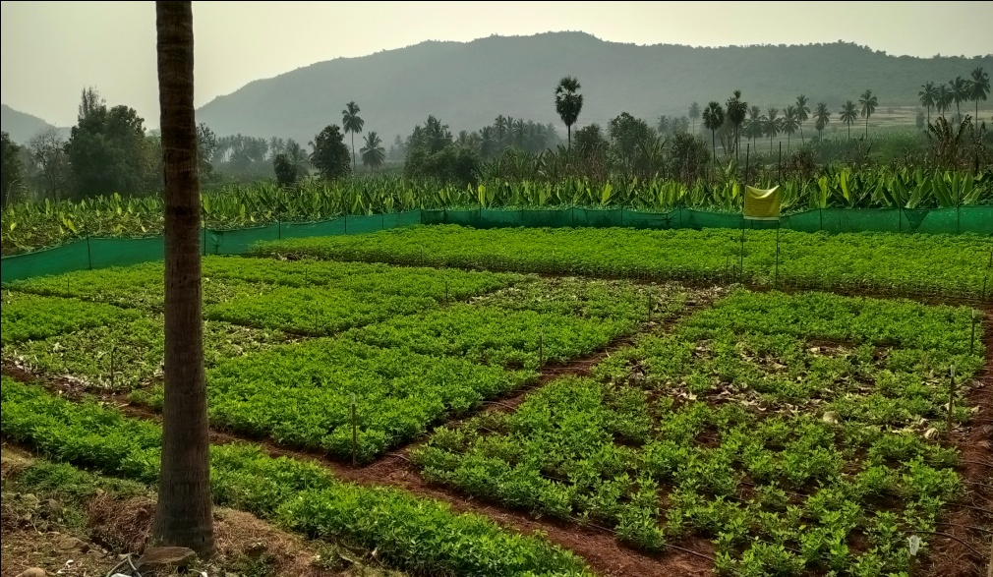
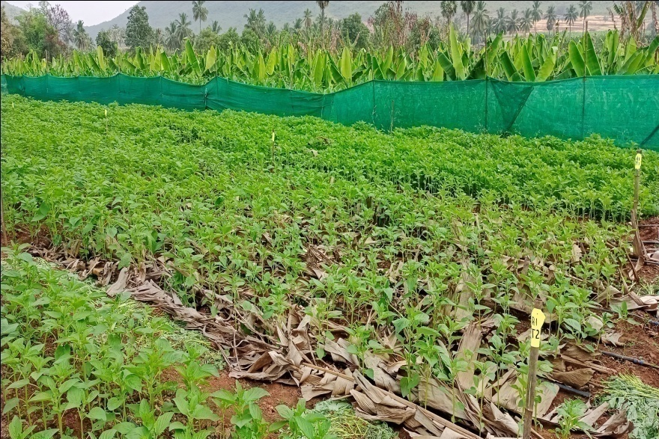
Research Activities of TNAU in the Promotion of Natural Farming
PG and Doctoral Research
Comparative evaluation of organic and natural farming practices in groundnut and sesame: Natural Farming package of practices have been standardized for sesame and groundnut (PhD)
Evaluation of natural farming practices in garden land ecosystem in western zone of Tamil Nadu : Cotton + Greengram - Sorghum + Chickpea – Multivarietal green manuring: Best cropping system for western zone of Tamil Nadu (PhD)
Nutrient flow, dynamics and budgeting in natural farming and assessment of soil health (PG)

Slide 9
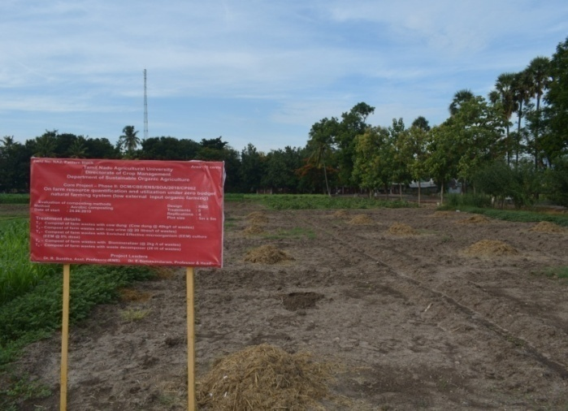
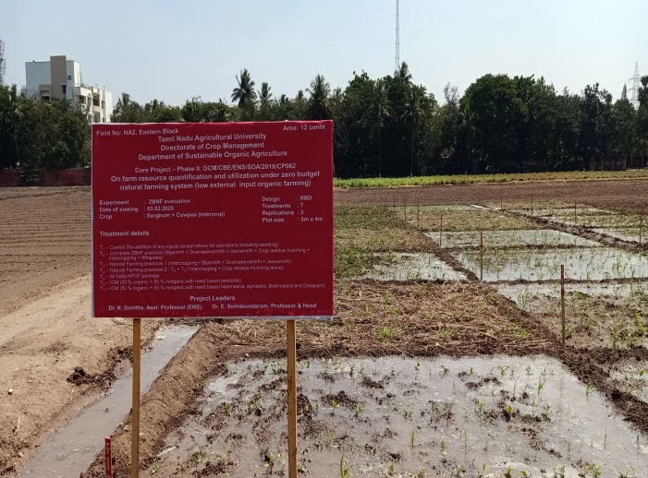
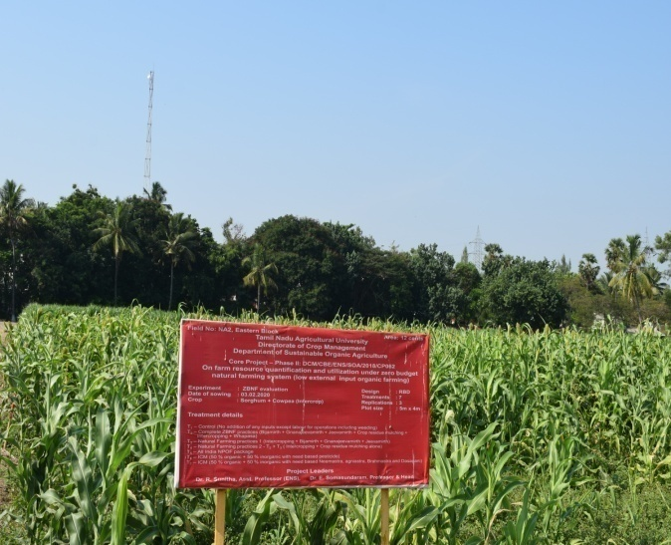
University Research Project
Research Activities of TNAU in the Promotion of Natural Farming
On-farm resource quantification and utilization under zero budget natural farming system
Cropping System: Sorghum + cowpea - Studied the impact on soil health, plant growth, yield and economics and ZBNF system recorded 24% increased yield over the control

Slide 10
EXTENSION

Slide 11
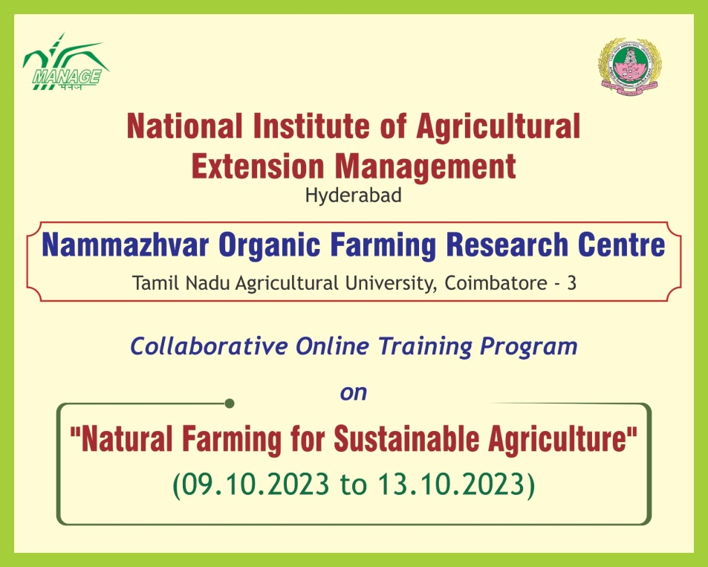
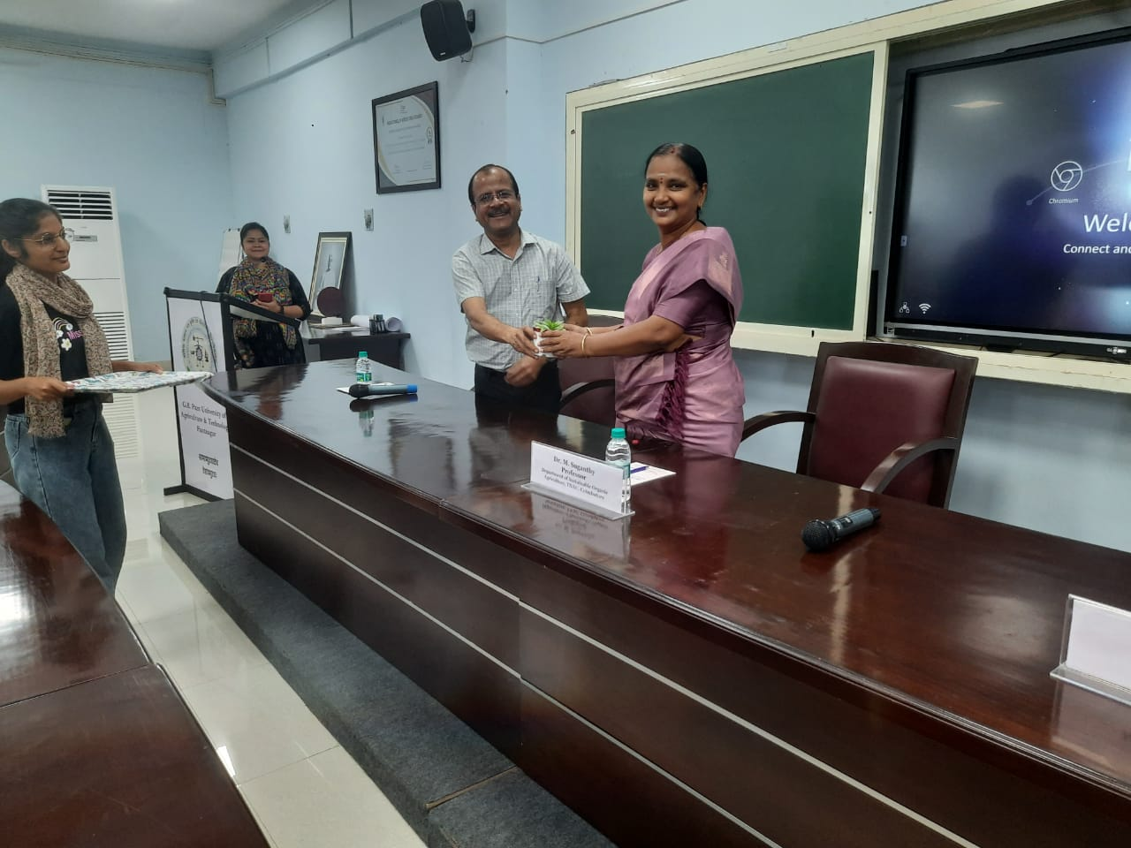
Extension Activities of TNAU in the Promotion of Natural Farming
Dr. R. Krishnan, Professor and Head, Dr. M. Suganthy, Professor (Entomology) and Dr. P. Janaki, Professor (Soil Science) of TNAU are serving as expert speakers / resource persons for the National Nodal Centres for Natural Farming - MANAGE and SAUs viz., GBPUAT, Pantnagar, MPUAT, Udaipur, UAHS, Shivamogga, ANGRAU, RARS, Anakapalle
TNAU & MANAGE - Collaborative online training program on “Natural Farming for Sustainable Agriculture” - 9th to 13th October, 2023 - 217 scientists, extension officers, KVK - SMS, students and progressive farmers are participating

Slide 12
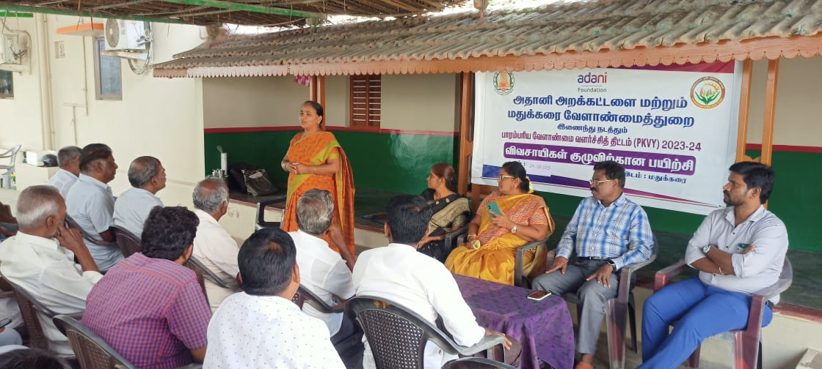
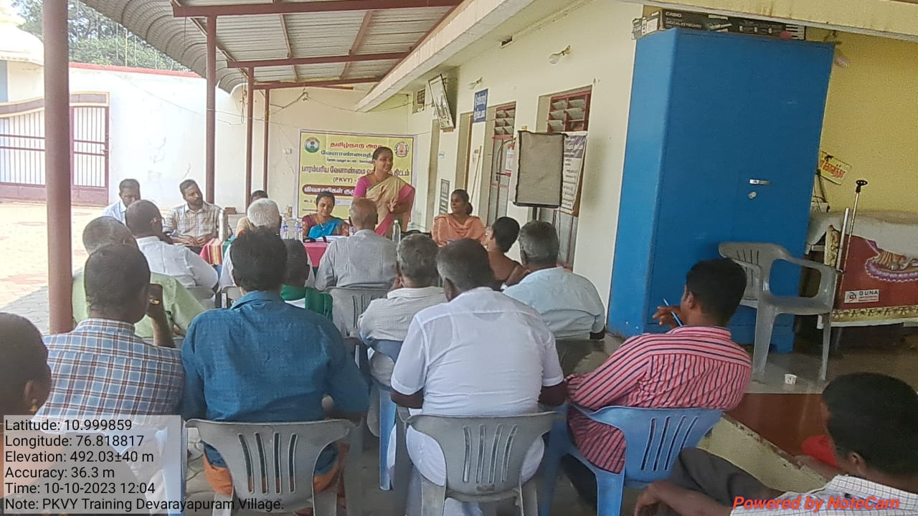
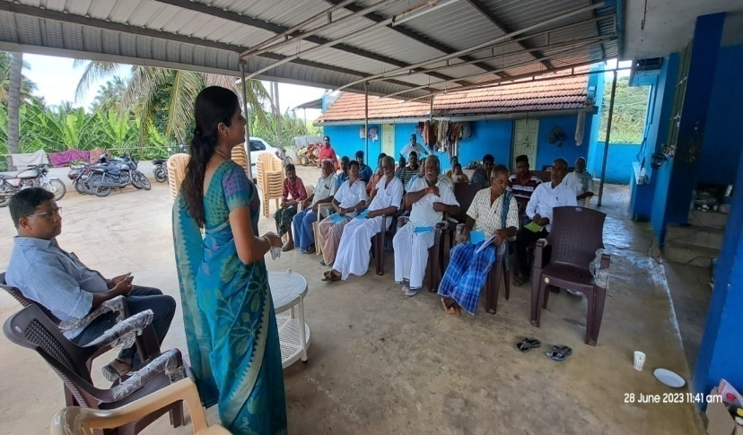
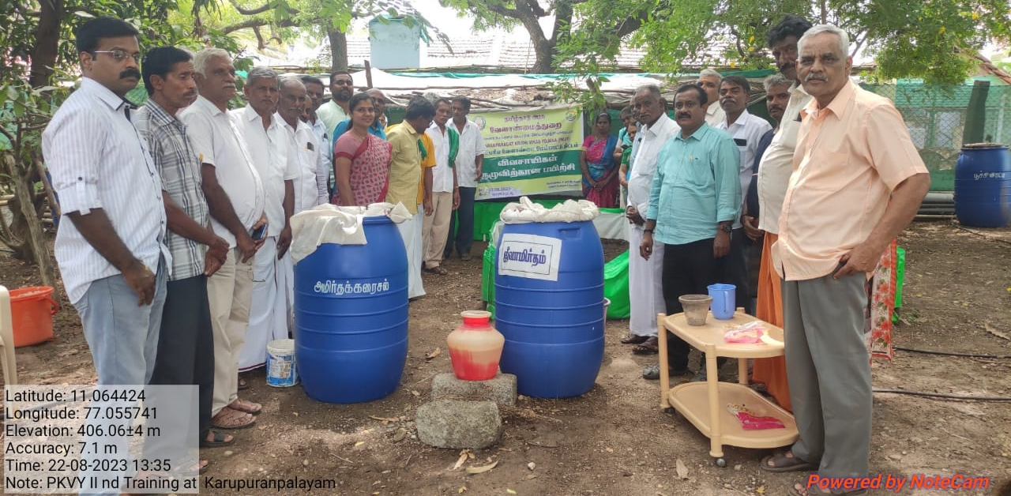
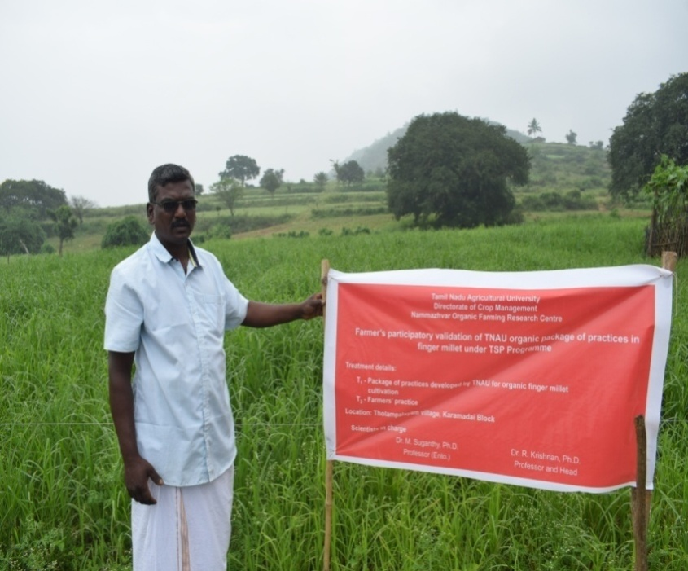
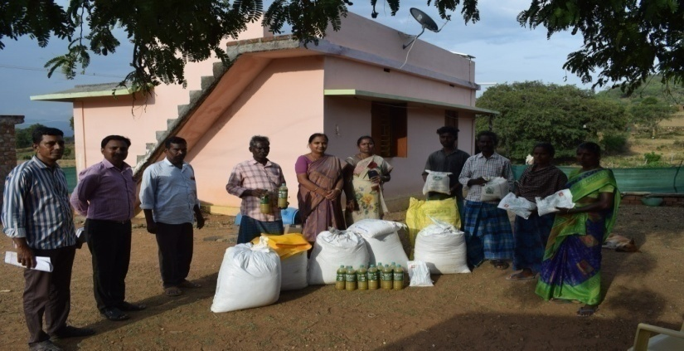
Extension Activities of TNAU in the Promotion of Natural Farming
Organized 8 trainings on “Natural Farming” to the Champion farmers and Community resource persons of The Nilgiris district
Trained 12 clusters consisting of 300 farmers on “Natural Farming Practices” under PKVY project in Coimbatore district
Conducted 32 Front Line Demonstrations on “Natural Farming practices for various crops” at farmers field (Cotton - 8; Groundnut - 8; Sorghum - 16)

Slide 13
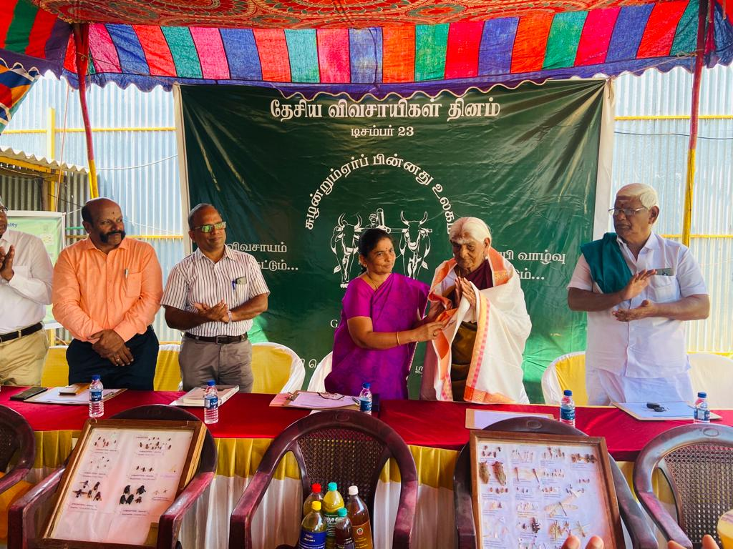
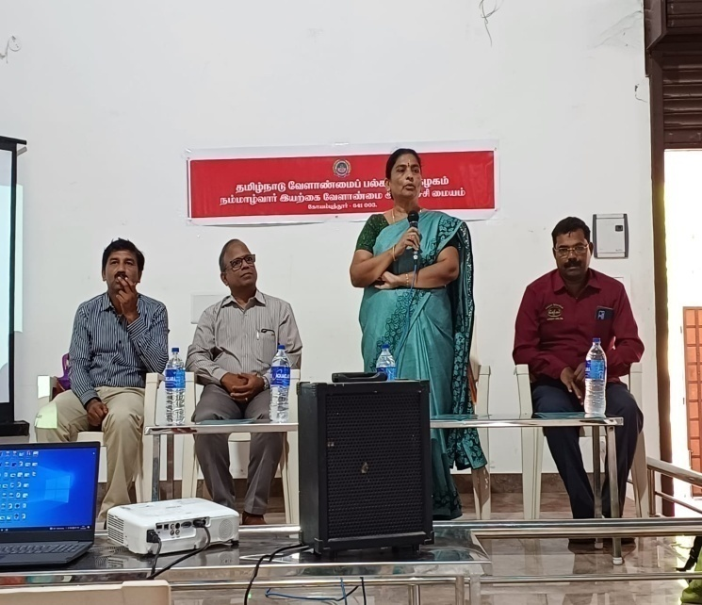
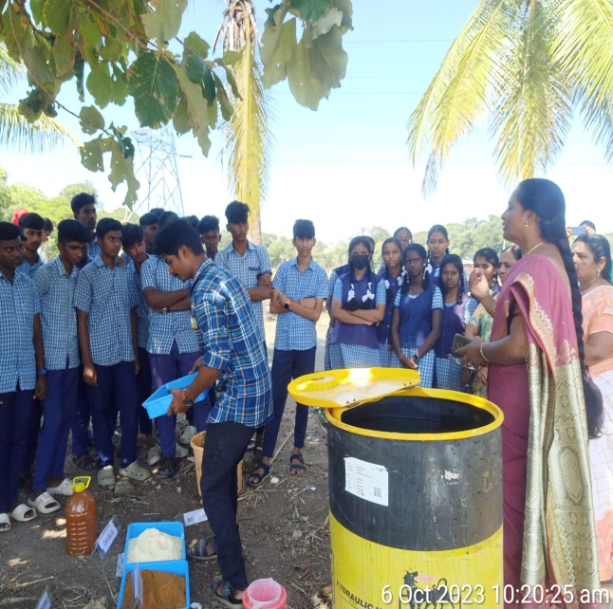
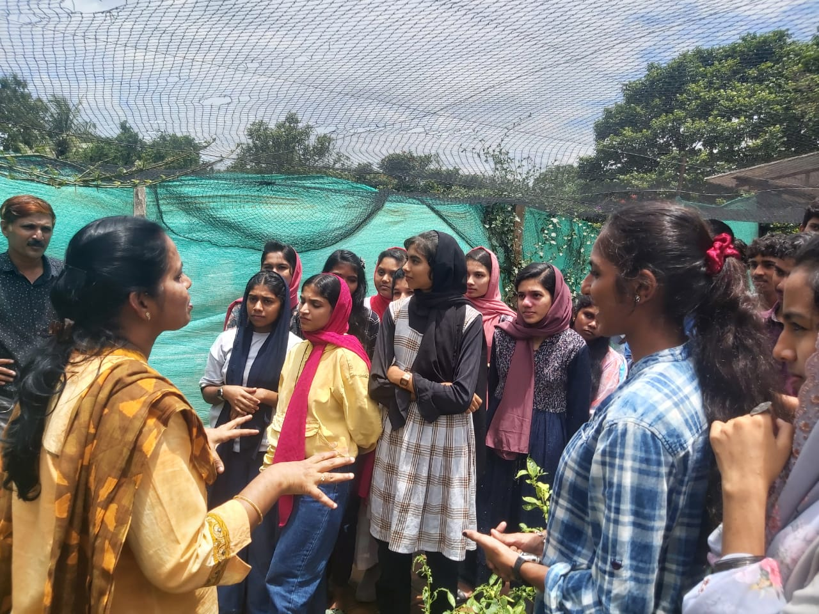
Extension Activities of TNAU in the Promotion of Natural Farming
Conducting monthly training on “Organic and Natural Farming” to farmers and stakeholders
Training on “Organic and Natural Farming” to the organic FPOs (8 trainings)
Five trainings to the school and college children of Tamil Nadu and Kerala on “Natural Farming” and providing hands on training on preparation of on-farm inputs.
Creating awareness on “Natural farming practices and inputs preparation” to college students, farmers, stakeholders through trainings, exhibitions and demonstrations

Slide 14
Experts / Scientists working on Natural Farming
S. No. | Name | Address | Mobile Number | E-mail | State | Name of the organization | Core area of work related to natural farming
1 | Dr. E. Somasundaram | Director (Agri-Business Development), TNAU, Coimbatore | 9443578172 | eagansomu@rediffmail.com | Tamil Nadu | Tamil Nadu Agricultural University | Cropping system approach, Weed management
2 | Dr. R. Krishnan | Professor and Head, NOFRC, TNAU, Coimbatore | 9443209452 | agrikrish@tnau.ac.in | Tamil Nadu |  | Cropping system approach, Weed management
3 | Dr. M. Suganthy | Professor (Entomology) NOFRC, TNAU, Coimbatore | 9486477255 | suganthy@tnau.ac.in | Tamil Nadu |  | Plant protection in natural farming and ecosystem services
4 | Dr. P. Janaki | Professor (Soil Science) NOFRC, TNAU, Coimbatore | 9443936160 | janaki.p@tnau.ac.in | Tamil Nadu |  | Soil health, nutrient management and ecosystem services
5 | Dr. M. Ramasubramanian | Professor (Extension) NOFRC, TNAU, Coimbatore | 9486734404 | ramagriextension@gmail.com | Tamil Nadu |  | Documentation of ITKs in natural farming
6 | Dr. E. Parameswari | Assoc. Prof. (Env. Science) NOFRC, TNAU, Coimbatore | 9688509232 | parameswari.e@tnau.ac.in | Tamil Nadu |  | Farm waste recycling and carbon footprint
7 | Dr. P. S. Kavitha | Assoc. Prof. (Horticulture) NOFRC, TNAU, Coimbatore | 9047065335 | kavitha.ps@tnau.ac.in | Tamil Nadu |  | Natural farming in horticultural crops

